Slide 1
Need for space
Car racing simulator…. In space!

Slide 2
Elevator pitch
Fast supercars racing in amazing planets fighting for first place.
Customizable cars, new planets and a thrilling story!
100 of planets to race on!

Slide 3
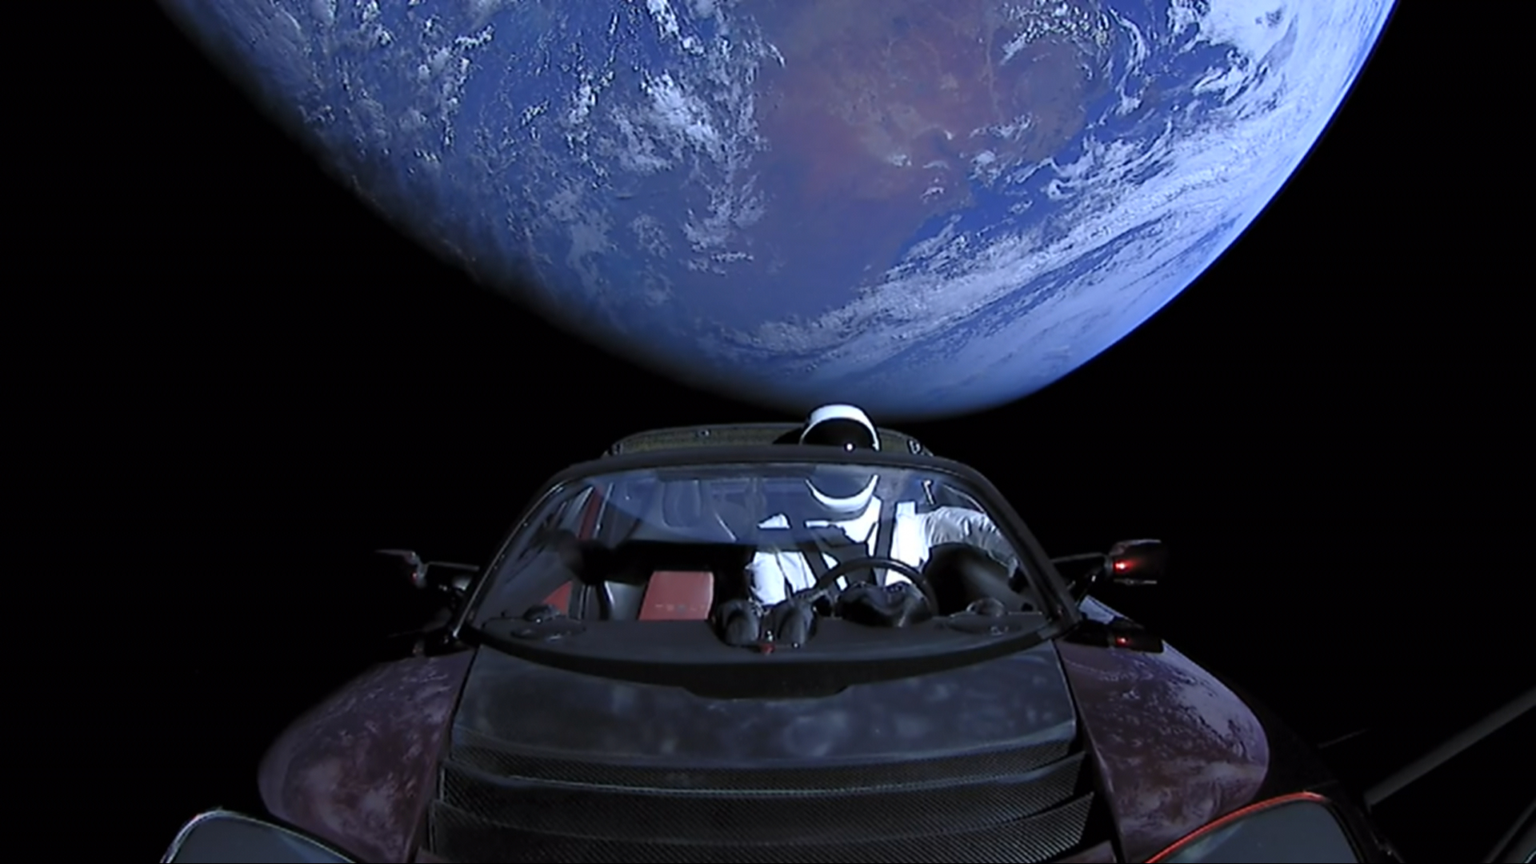
World background
The game is set in space, there are different galaxies and planets.
The players can visit planets to race on them and win prices and new cars.

